Slide 1



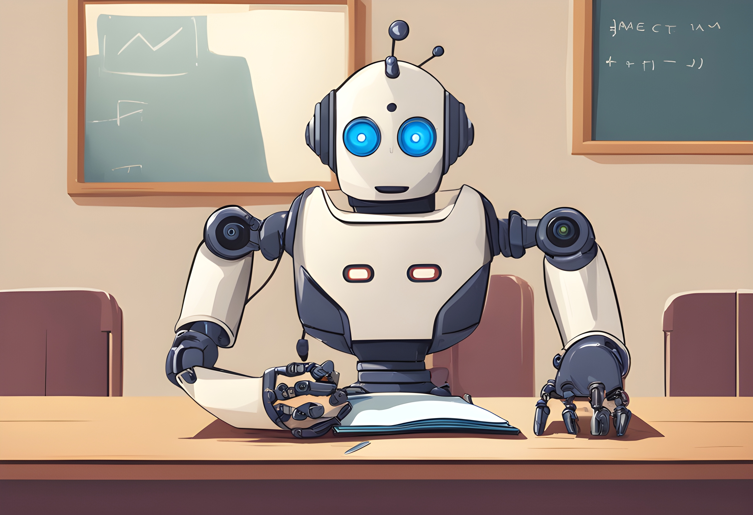
Final Project
Nick Griebel
CIS129
05/15/2024
Development of a long-term artificial intelligence teacher intended for kindergarten through higher education

Slide 2

Overview
In today's world, individual students often lack much-needed personal attention in school. My idea proposes an AI teacher that follows the student through their school lives from kindergarten to college, constantly learning more about its student, and personalizing its teaching style to obtain maximum benefit for the student.
The original idea was proposed by Steve Wozniak of Apple Computers.
There are significant advantages to be gained by this form of teaching that would benefit the students, however there are also disadvantages that could potentially cause problems for students.

Slide 3
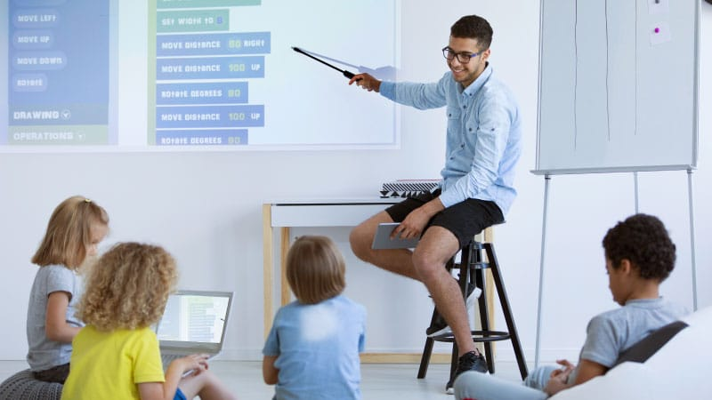
Acceptance of AI Teachers
Willingness to accept AI in the classroom is very slow-growing, but not non-existent.
Current advancements in AI are taking place very quickly, and acceptance of wide-spread AI use is high. How would AI teachers advance education?
According to a study conducted by E Park [1], AI tutors were greeted with an excellent success rate. These tutors were seen as very helpful, and students found its' positive advice very uplifting. It was found that so called "Social Robots" had a positive effect on students.
Technology is expanding every day. Education started with teachers teaching students with books and chalk boards. In present times, computers are utilized to perform most of the teaching tasks. With this mindset of growing with technology, AI teachers could be the next breakthrough that the world needs.

